Slide 1



PISA 2025 Main Study
(March-April 2025)
Information for private English-speaking schools
Modestina Modestou
Christiana Nicolaou
PISA 2025 Cyprus National Centre
Centre for Educational Research and Evaluation

Slide 2
The purpose of this presentation
Overview of PISA
PISA 2025 Main Study: Content and procedures
Role and responsibilities for participating schools
School Principals’ support
Use of PISA Released Material
Effective ways for promoting PISA
PISA results (2012-2022)

Slide 3

Overview of PISA
What is PISA?
  The Programme for International Student Assessment (PISA) took place for the first time in 2000
  15-year-old students: end of compulsory education
  PISA surveys take place in three-year cycles
  The 9th PISA cycle will take place in 2025
  More than 95 countries participate in PISA 2025 – 5th participation for Cyprus
Who organizes PISA?
  Organization for Economic Cooperation and Development (OECD)
  An international consortium is responsible for the development and management of the Programme
  Every country has its own PISA National Center
    Centre for Educational Research and Evaluation(CERE)

Slide 4
Overview of PISA
What does PISA assess?
PISA assesses students’ performance in:
science
mathematics
reading
Learning in the Digital World (innovative domain)
Proficiency levels

Slide 5
Overview of PISA
Proficiency Levels
PISA uses proficiency levels to indicate the type of skills students are able to use at each level, for each cognitive domain.
Level 1 is the lowest and level 6 is the highest proficiency level
Level 2 is considered the baseline level
  Students at this level present a number of basic skills, which will allow them to integrate and participate efficiently in the social and civic life.

Slide 6
Overview of PISA
Who takes part in PISA?
15-year-old students (end of compulsory education)
Student eligibility is strictly age-based.
NOT related to student grade or programme of study.
What are students’ motives for participating in PISA?
  PISA is NOT related to any kind of school assessment
  Students are NOT informed about their results
  Internal motivation for achieving goals

Slide 7
PISA 2025 Main Study
Information - training - promotional material
  Informational meetings
    September 2024 – School Inspectors and Academics
    November 2024 – PISA Conference for School Coordinators & School Principals
    January 2025– School Coordinators
  PISA 2025 promotional material
    Posters, website, letter to parents

Slide 8
PISA 2025 Main Study
Testing period
3rd March – 11th April 2025
The testing schedule will be prepared by the PISA 2025 Cyprus National Centre in collaboration with the schools
Note:
Holidays and national celebrations will be taken into consideration.

Slide 9
PISA 2025 Main Study
Which schools participate?
    School selection criteria:
    ALL Public – Greek schools with PISA-eligible students
    ALL Private – English & Greek schools with PISA-eligible students
TSG: Minimum number of schools = 150

Slide 10


Data collection tools
Cognitive test
- science
- mathematics
- reading
- learning in the digital world
2 hours
Questionnaire
student
school
35 minutes
60 minutes
    fully computer-based
    administration of the assessment

Slide 11
Student sample & Computer labs needed
PRIVATE SCHOOLS
  Sample: all students
  The number of required computer labs depends on the number of students tested
On the day of the assessment the computer labs
should be available throughout the day.

Slide 12
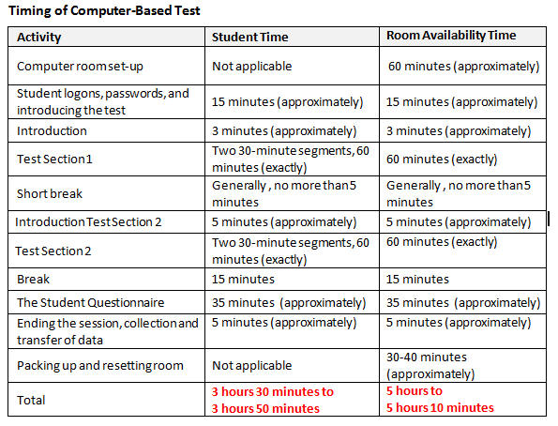
The day of the assessment
(preliminary)

Slide 13
Clarification
Test administration will be conducted by external personnel that will be hired and trained by the PISA 2025 Cyprus National Centre
School staff: Invigilators

Slide 14
Equipment – Computers
The successful implementation of the survey relies heavily on school computers used to administer the test.
Computers need to be tested by means of a special software, in order to establish that they can run the test.
If a small additional number of computers is needed: use of laptops
If a considerable additional number of computers is needed: administration of the assessment on two or more days
The cooperation of IT teachers is very important:
  a) for the prompt testing of computers and the submission of reliable data
  b) for the smooth administration on the day of the assessment

Slide 15

The School’s role and responsibilities
The School Coordinator will be responsible (among other things!) for the following:
Frequent communication with the PISA 2025 Cyprus National Centre
Prompt submission of the (named) list of PISA-eligible students (ALL students who were born in 2009)
Correct implementation of the procedure for excluding students with special educational needs, on the basis of certain criteria
Cooperating with IT teachers for running the technical/diagnostic tests for computers – Prompt submission of reliable data
Promotion of the survey within the school (towards teachers and students)
Cooperation and coordination with Test Administrators, prior to and on the day of the assessment

Slide 16
School Coordinator
School Coordinators’ (SC) Meeting:
On-line: January 2025
Detailed School Coordinator’s Manual, which describes all the steps and processes of the survey.

Slide 17
The School’s role – Principal’s support
  Preparation
  Promoting a positive climate among teachers and students
  Use of promotional material (posters, website)
  Students should take the test seriously – Avoid leaving questions unanswered
  Teachers should be informed of the availability of the released material and be encouraged to use it in class (in all subjects tested)
  Support your School Coordinator!

Slide 18
The School’s role – Principal’s support
  Informing parents
  The PISA 2025 Cyprus National Centre will prepare a letter addressed to parents, which will be available to schools a few days before the beginning of the testing period
  Parents consent is not needed
  Parents have the right to refuse participation (should be limited)

Slide 19
The School’s role – Principal’s support
  Day of the assessment
  Clear (…and strict) instructions to students with regards to the procedures and timing on the day of the assessment
  Supervision by members of staff
  List of sampled students on the door of each room
  Strict (common) policy on: a) break time arrangements and b) early completion of the test
  Use of mobile phones is prohibited
  Providing supportive material (e.g. stationery, calculators, literature books, magazines)

Slide 20
The School’s role – Principal’s support
  Day of the assessment
  It is extremely important to achieve a high attendance / participation rate, on the day of the assessment
  If too many students are absent on the day of the assessment this will result to:
  a) organizing a follow-up test for the school,
  b) the removal of the school’s data from the country’s data file
  Low participation rates cause serious problems, especially if they do not meet the technical standards of the Programme.

Slide 21
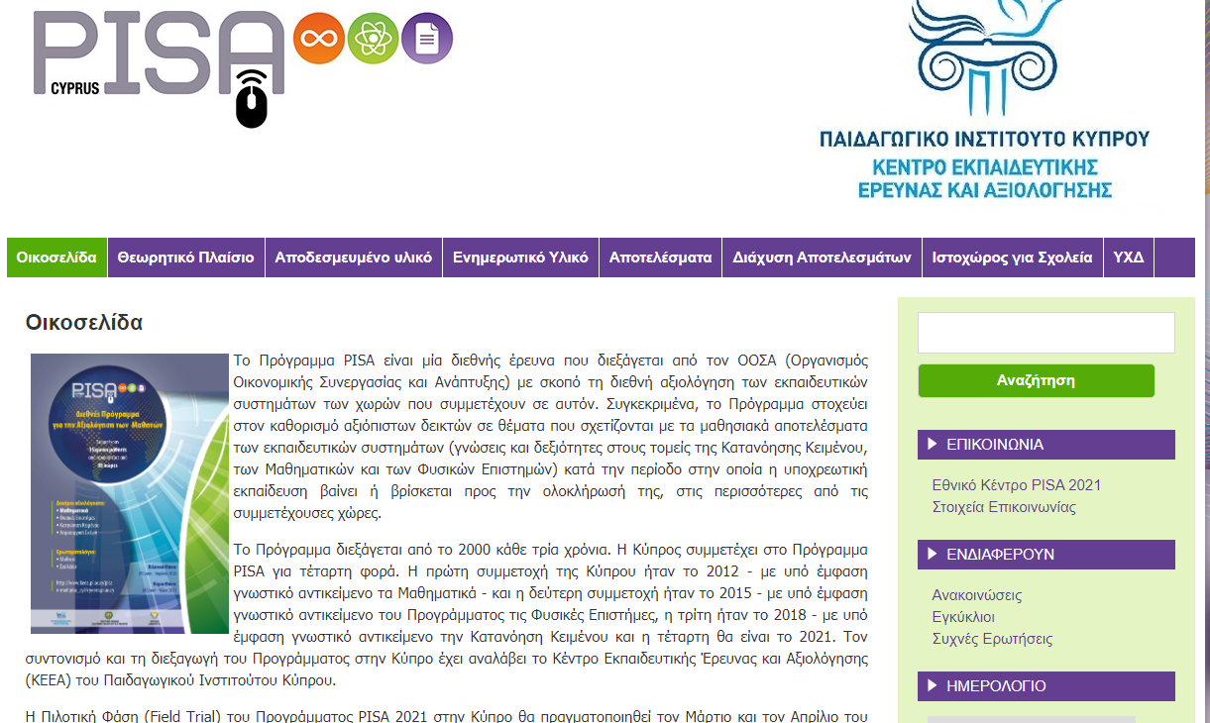

Finding out more about PISA:
http://keea-pisa.pi.ac.cy/pisa/
http://www.pisa.oecd.org

Slide 22
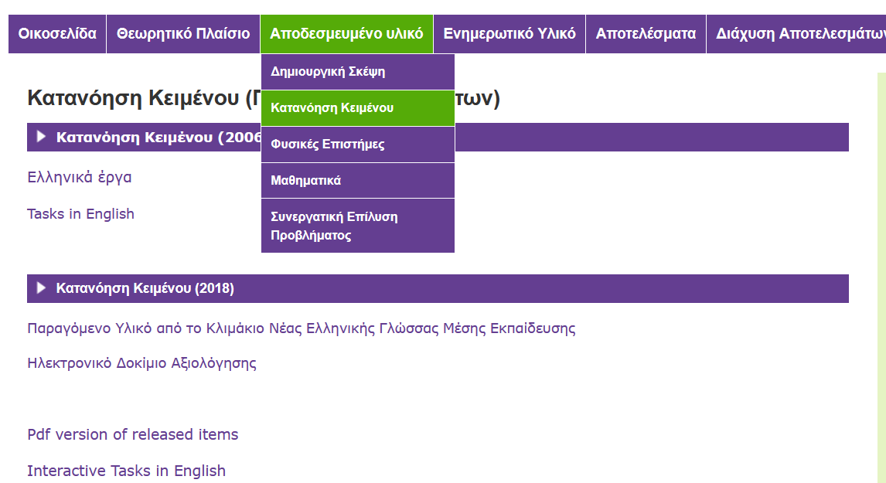
Released Material
Samples of publicized test items

Slide 23
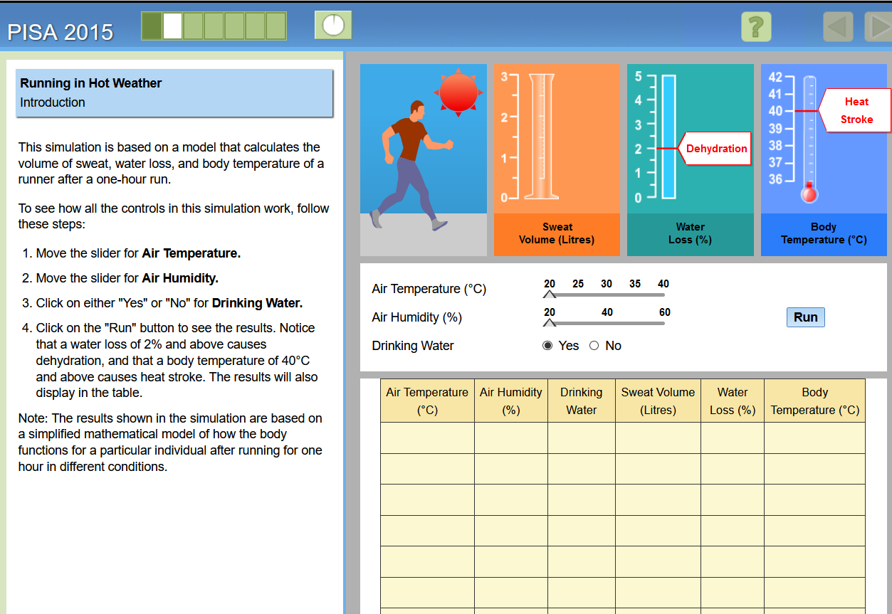
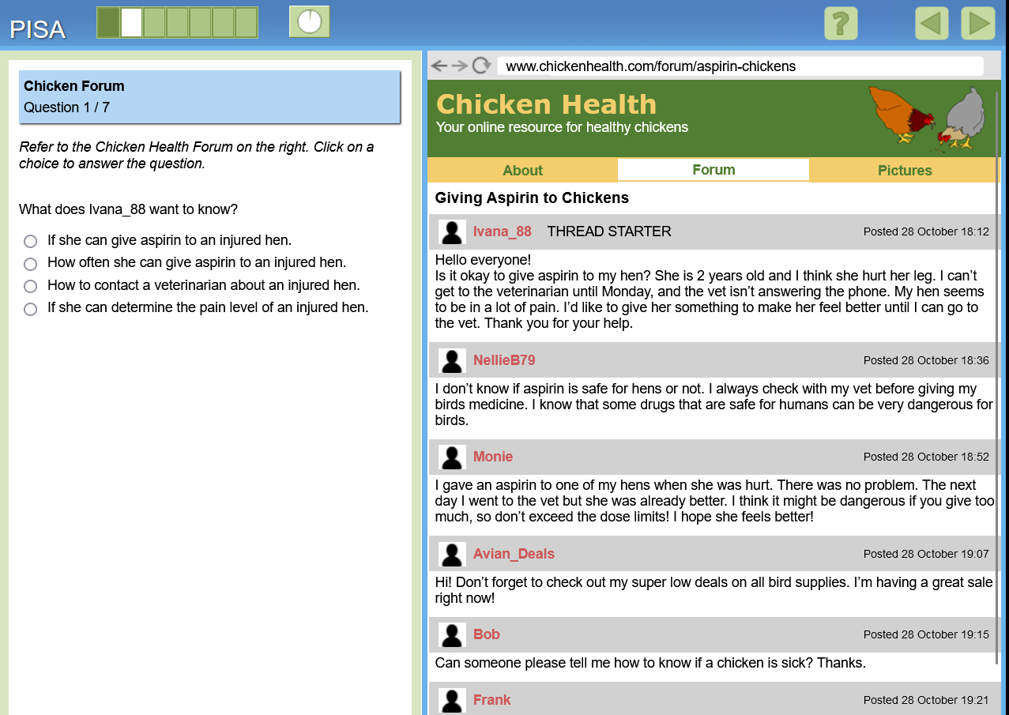
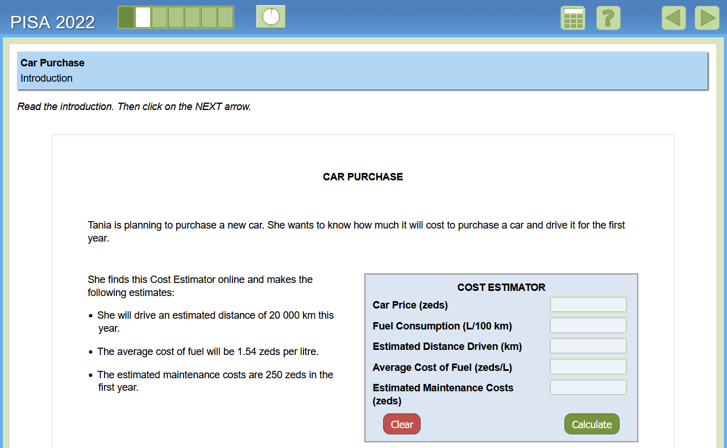
Released Material
Samples of released test items
https://www.oecd.org/en/about/programmes/pisa/pisa-test.html

Slide 24
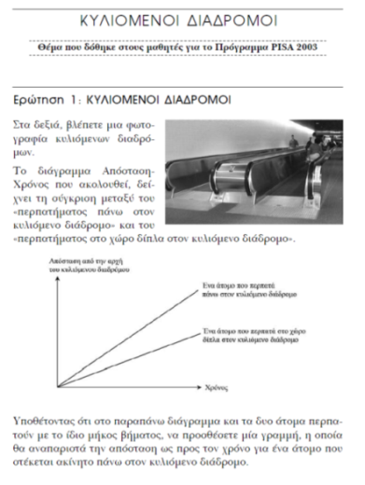
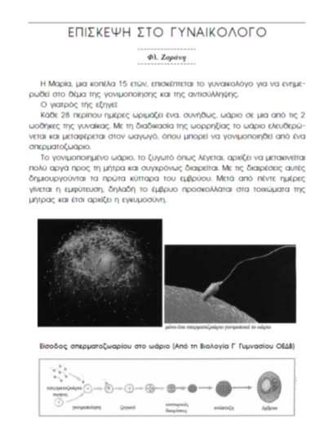
Using released material
Using the released material is EXTREMELY useful, since it allows students to familiarize themselves with the content and the nature of PISA questions.
a) Teachers are encouraged to use at least one exercise, per month, per subject, with their students.
b) Students should also be encouraged to practice with the released material, in their free time.

Slide 25


Communication with PISA 2025 Cyprus National Centre:
email: pisa_cyschools@cyearn.pi.ac.cy
National Project Manager: Yiasemina Karagiorgi (22 402317)
Coordinating Team:
Modestina Modestou (22 402474)
Christiana Nicolaou (22 402470)
Aristoklis Nikolaou (22 402472)
Fax: 22 560118

Slide 26
PISA 2025 Main Study
(March-April 2025)
Thank you for your cooperation
PISA 2025 Cyprus National Centre
Centre for Educational Research and Evaluation

Slide 27

PISA RESULTS (2012-2022)
Cyprus
EU
Means
Proficiency levels

Slide 28


PISA results
MATHEMATICS

Slide 29
Mathematics
CYPRUS
EU
Notes:
54 μονάδες διαφορά με ΕΕ
Πτώση 33 μονάδες από 2018 /22 μονάδες από 2012
Πτώση στην ΕΕ 15 μονάδες
Η πτώση αυτή είναι πρωτοφανής, δεδομένου ότι η αλλαγή στην επίδοση σε διαδοχικές αξιολογήσεις PISA δεν είχε ποτέ ξεπεράσει τις 4 μονάδες σε διεθνές επίπεδο, ενώ ανάμεσα στο 2015 και το 2018 παρατηρήθηκε μια σταθερή τάση

Slide 30
Mathematics – Proficiency levels
EU 2022
EU 2018
Cyprus 2022
Cyprus 2018
%
Below Level 2
Levels 5 & 6
Notes:
16% αύξηση από 2018

Slide 31
Mathematics by gender
Girls (Cyprus)
Boys (Cyprus)
Girls (EU)
Boys (EU)
Notes:
15 μονάδες διαφορά Α- Κ στην Κύπρο – Διπλασιάστηκε από το 2018 (8 μονάδες)
6 στην ΕΕ – 4 μονάδες το 2018

Slide 32

PISA results
SCIENCE

Slide 33
SCIENCE
CYPRUS
EU
Notes:
69 μονάδες διαφορά με ΕΕ
Πτώση 28 μονάδες από 2018

Slide 34
Science – Proficiency levels
Notes:
Διπλάσιο το ποσοστό από ΕΕ
13% αύξηση από 2018

Slide 35
Science by gender
Girls (Cyprus)
Boys (Cyprus)
Girls (EU)
Boys (EU)
Notes:
29 μονάδες διαφορά Α- Κ στην Κύπρο –
2012: 13 μονάδες -→16 μονάδες αύξηση
4 στην ΕΕ (σταθερή διαφορά)

Slide 36

PISA results
READING

Slide 37
READING
CYPRUS
EU
Notes:
87 μονάδες διαφορά με ΕΕ
Πτώση 43 μονάδες από 2018 ---- 2012: πτώση 68 μονάδες
ΕΕ Πτώση 14 μονάδες από 2018

Slide 38
Reading – Proficiency levels
EU 2022
EU 2018
Cyprus 2022
Cyprus 2018
Below Level 2
Levels 5 & 6
Notes:
6 στους 10 μαθητές δεν έχει τις βασικές δεξιότητες στην κατανόηση κειμένου
Διπλάσιο το ποσοστό από ΕΕ
17% αύξηση από 2018
Στα ανώτερα επίπεδα κατατάσσεται μόλις το 1% των μαθητών.

Slide 39
Reading by gender
Girls (Cyprus)
Boys (Cyprus)
Girls (EU)
Boys (EU)
Notes:
54 μονάδες διαφορά Α- Κ στην Κύπρο – 2012: 50 μονάδες
28 στην ΕΕ (σταθερή διαφορά)

